Slide 1
OGC Geotech Interoperability Experiment
Kickoff Meeting
22 February 2022

Slide 2
Agenda
Welcome and overview of IE process – Scott Simmons, OGC
Introductions – all attendees
Geotech IE main objectives – Mickaël Beaufils, BRGM
Presentation of IFC Tunnel GeoSubGroup work and data model - Jonas Weil, IC Group
Detailed work packages description – Mickaël Beaufils
Work Organization – Mickaël Beaufils and Scott Simmons

Slide 3


Slide 5
Interoperability Experiments

Slide 6
OGC Innovation Continuum
Innovation Roadmap Development
( What )
Innovation Roadmap Execution
( How )
Call for Sponsors
DWG discussion
Create public call
SWG formation
Identify
Project
Innovation
Cycle
Standardization Cycle
Standards development
Select best members
Interest gathering
DWG/SWG Presentation
Executive
Project
Generate Results
Formulation of enhancements

Slide 7
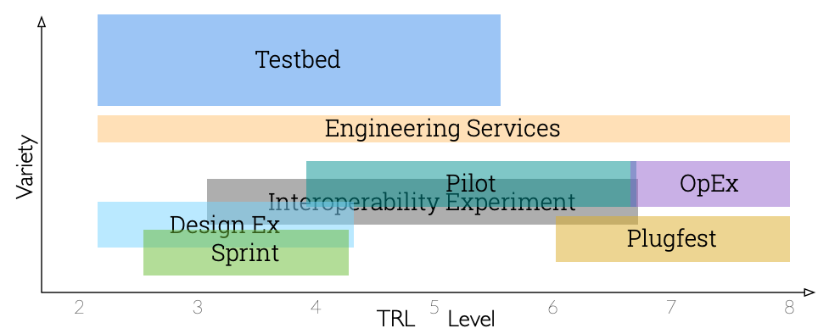
Innovation initiatives

Slide 8
What is an OGC Interoperability Experiment
Applied research initiative led by OGC members and supported by OGC staff
Non-member participation is allowed (usually as observers, more full participation is permitted in this IE)
All participation is in-kind
Topics are focused with the objective of solving interoperability issues of interest to the member leadership
Normally run 6 – 12 months
Results documented in Engineering Report(s) or other OGC documents and generally used to define new Standardization work

Slide 9

Who
Initiative lead (OGC Member) - Mickaël Beaufils (BRGM, MINnD, TC 222)
OGC Staff lead - Scott Simmons

Slide 10
Introductions

Slide 11

Thank You
Community

